Slide 1
Project: SwashSim – Signalized Intersection, VTAPE, etc.…
Tae Kim
Computer Science, College of Engineering
University of Florida
&
Dr. Scott Washburn
Department of Civil and Coastal Engineering
University of Florida

Slide 2
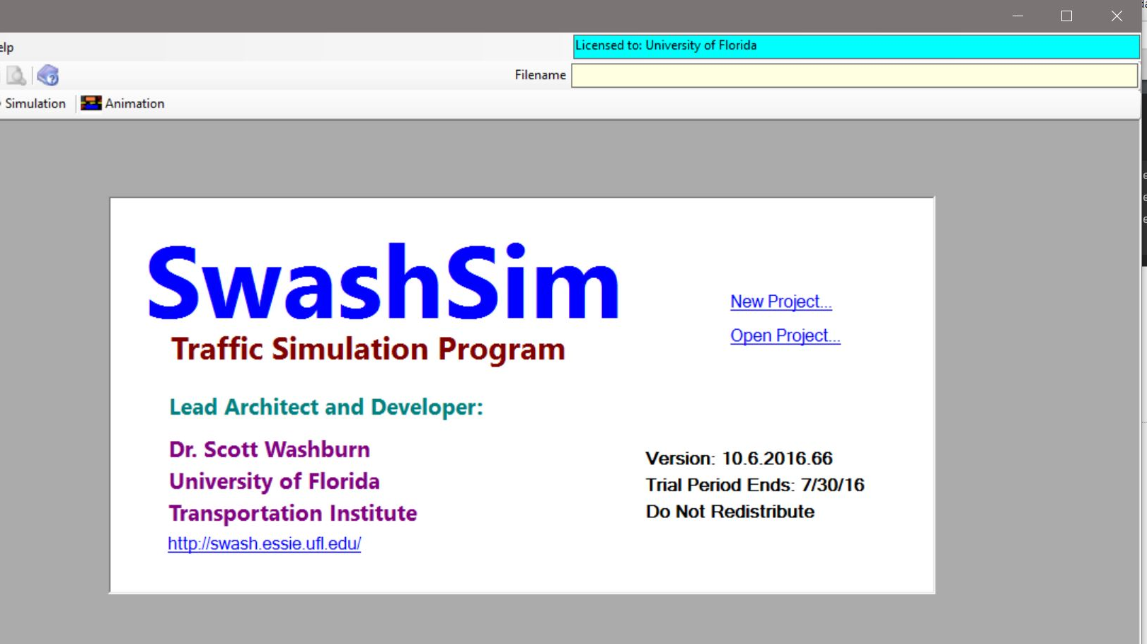
SwashSim – Signalized Intersection
Overview of SwashSim.
Purpose of signalized intersection simulation.
Microsimulation.

Slide 3
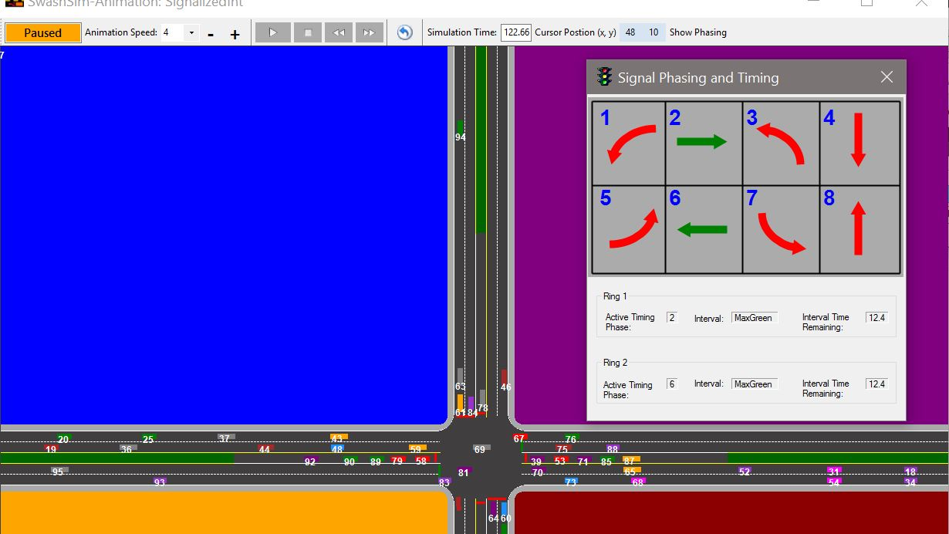
Signalized Intersection – Pretimed Control
Demonstration –
Split Phase.
Lagging Left Phases.
Simulation & Animation.
Results.

Slide 4
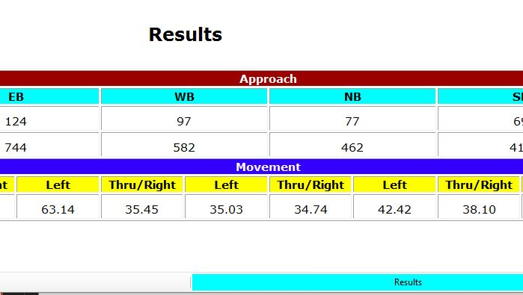
Manual Delay Calculation
East bound delay.
Manual confirmation of SwashSim’s delay calculation function.
Vehicle Time Step Data – CSV files.

Slide 5
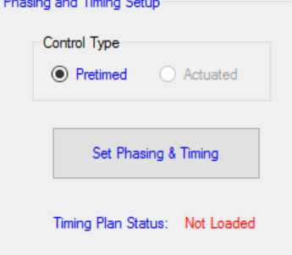
Touch on Actuated Control & User Manual Fix
Brief touch on Actuated Control.
Short testing period.
Assist on updating SwashSim User Manual.

Slide 6
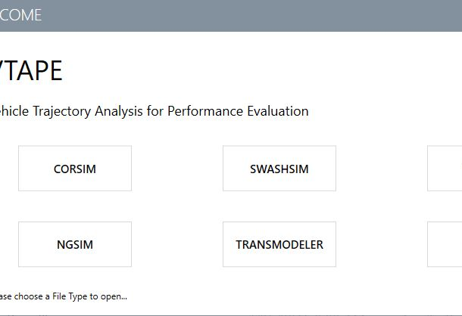
VTAPE
Overview of VTAPE.
Developed by Bin Lu and Dr. Washburn.

Slide 7
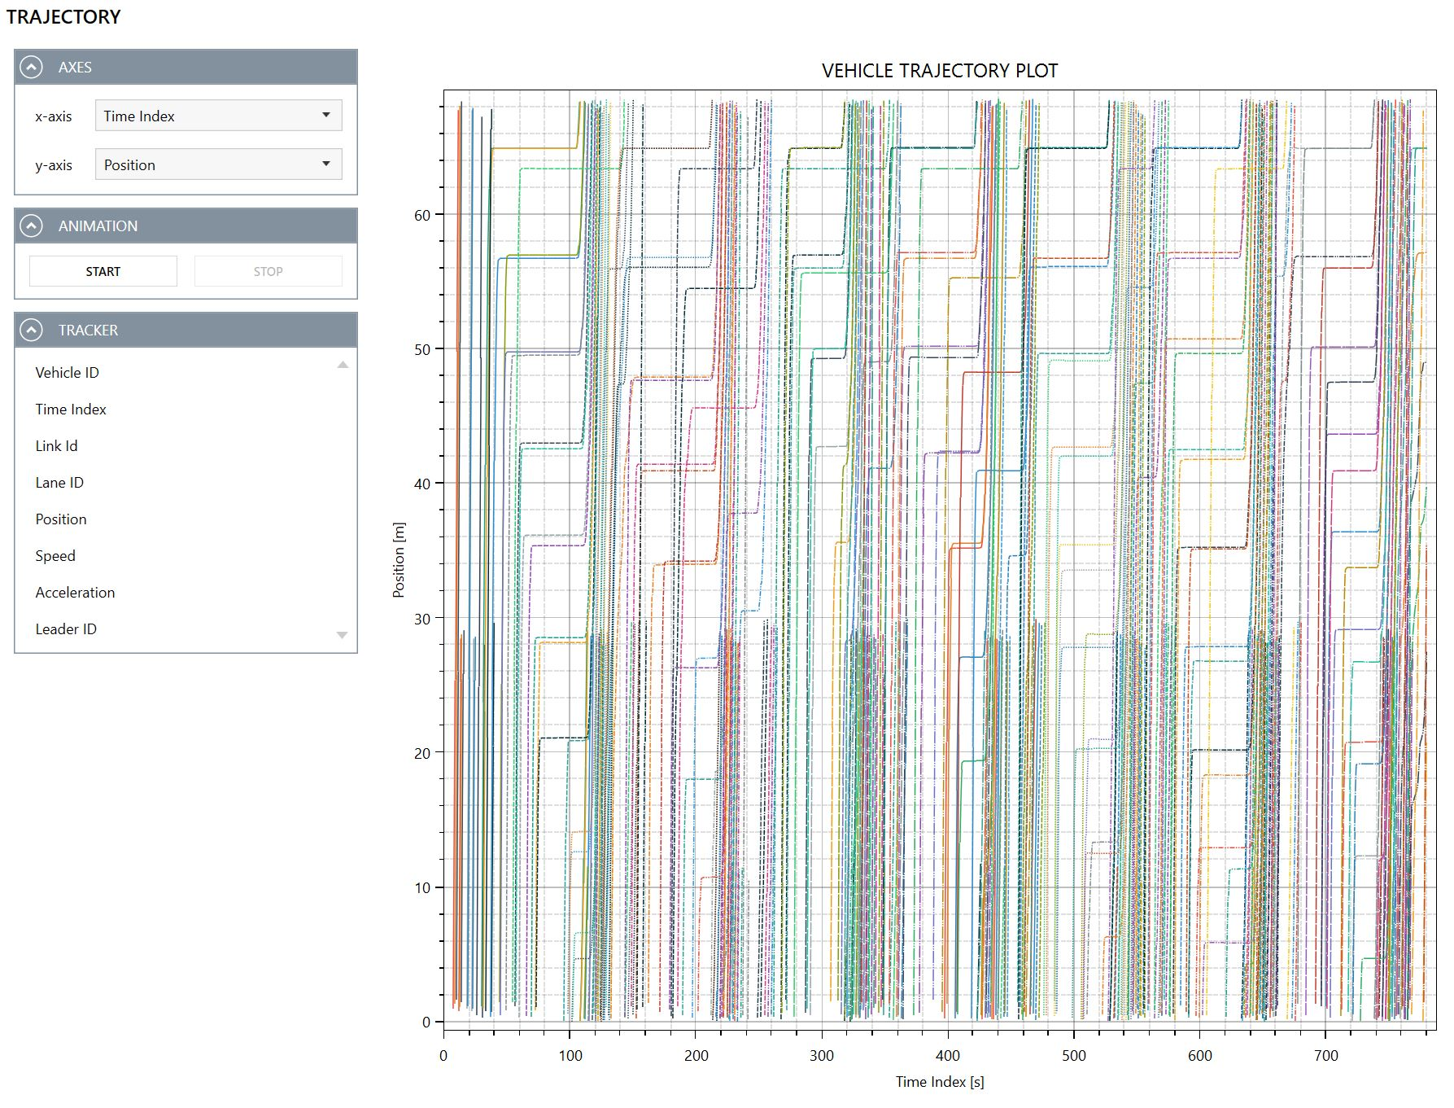
VTAPE Cont’d
Vehicle Movement Trajectory.
Performance Verification.

Slide 8
Truck Parking Detection Project.
Field trip to I-75 Rest Area to experience big, state-wide project.
Experience on the detection technology.
Radar
Sonar
Etc.

